Slide 1
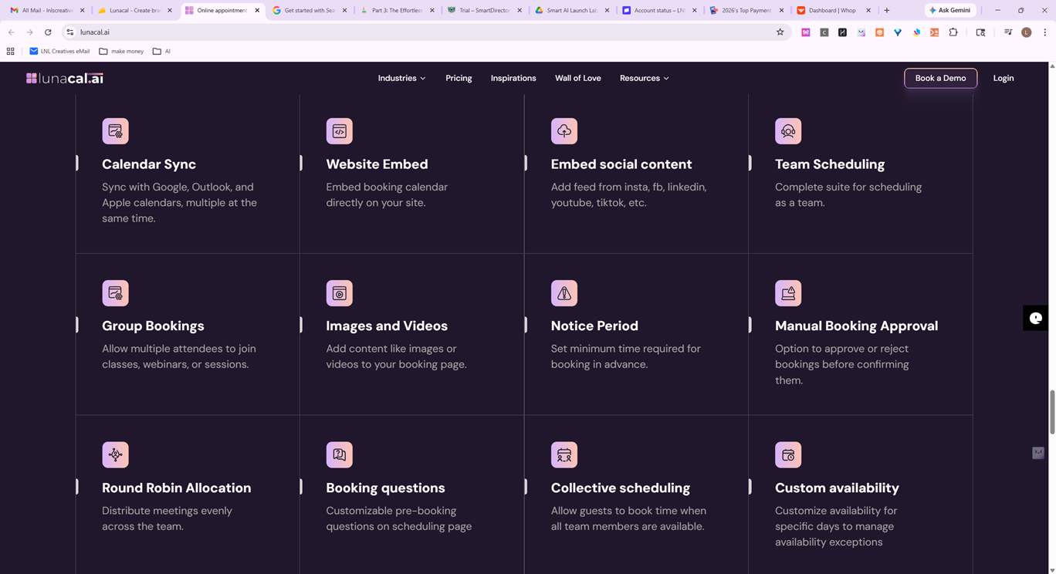

Slide 2
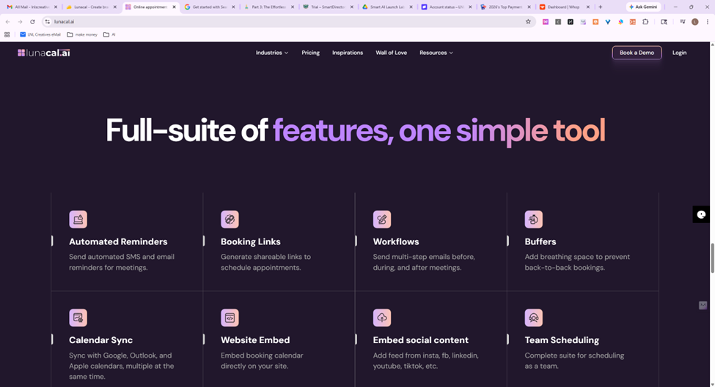

Slide 3
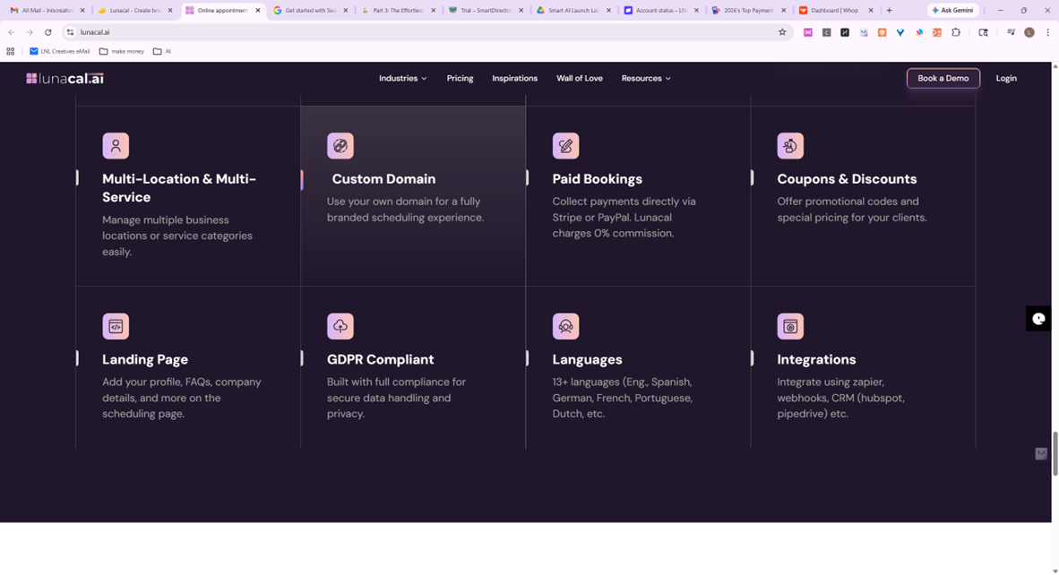

Slide 4
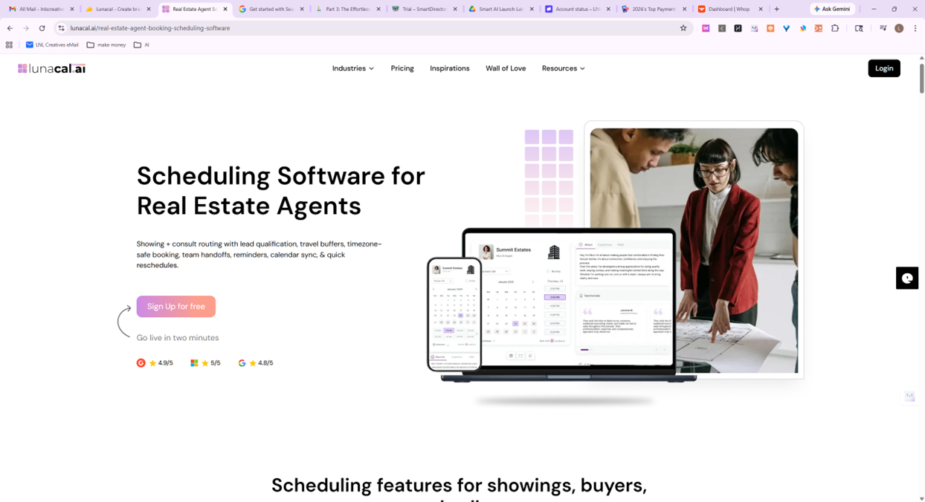

Slide 5
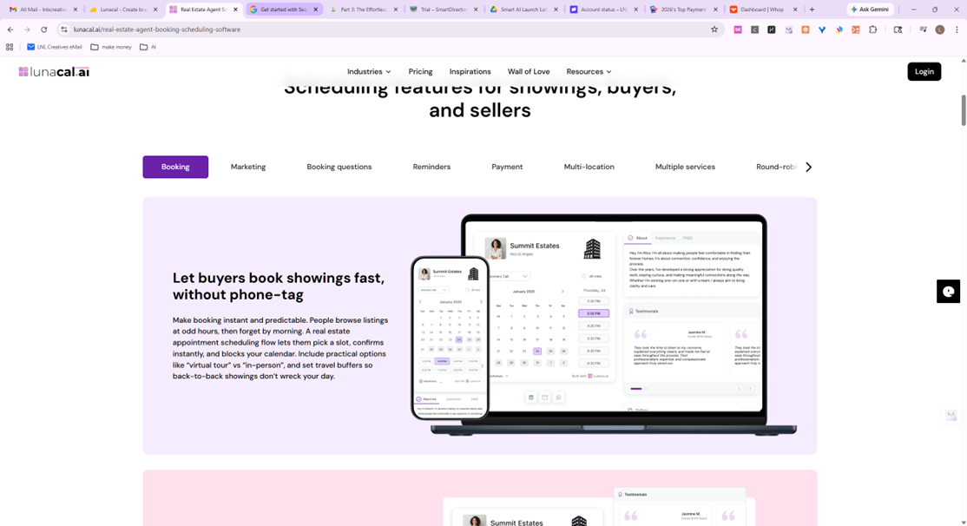

Slide 6
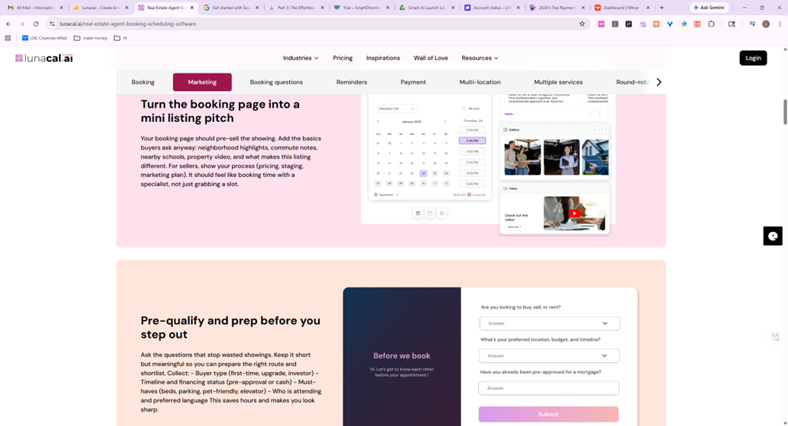

Slide 7
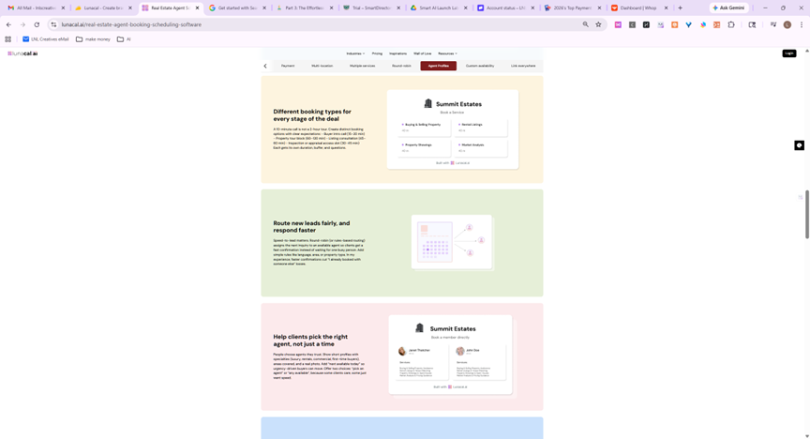

Slide 8
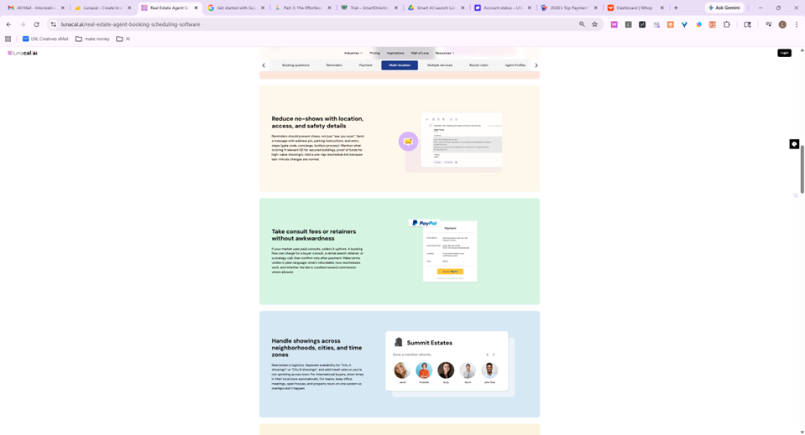

Slide 9
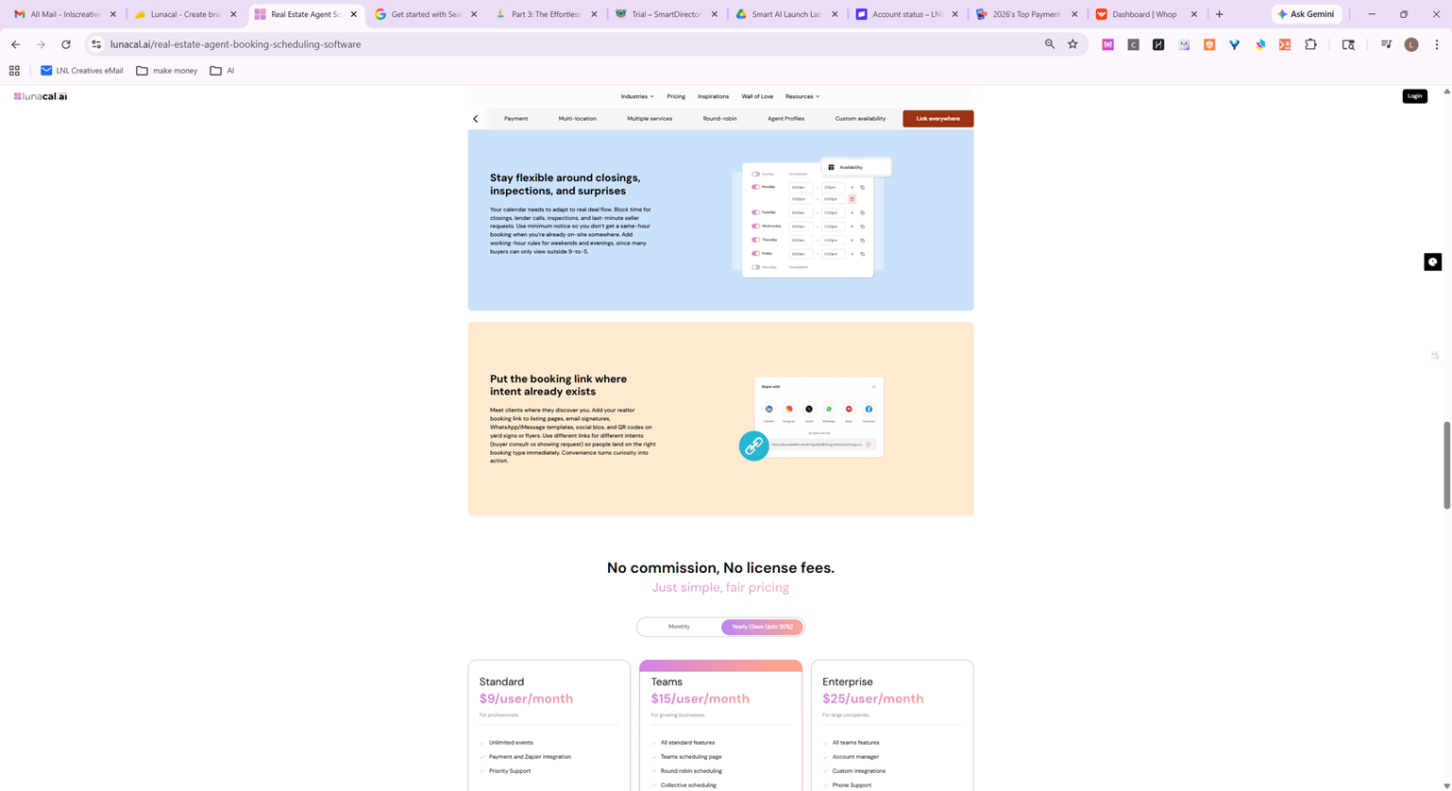

Slide 10
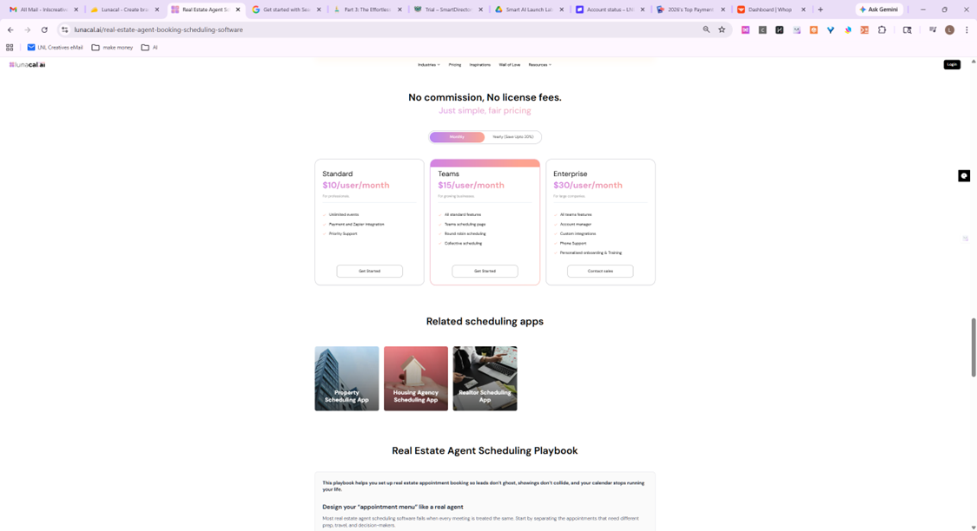

Slide 11
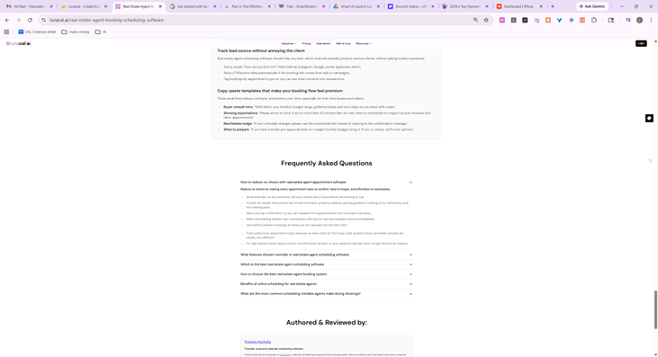

Slide 12
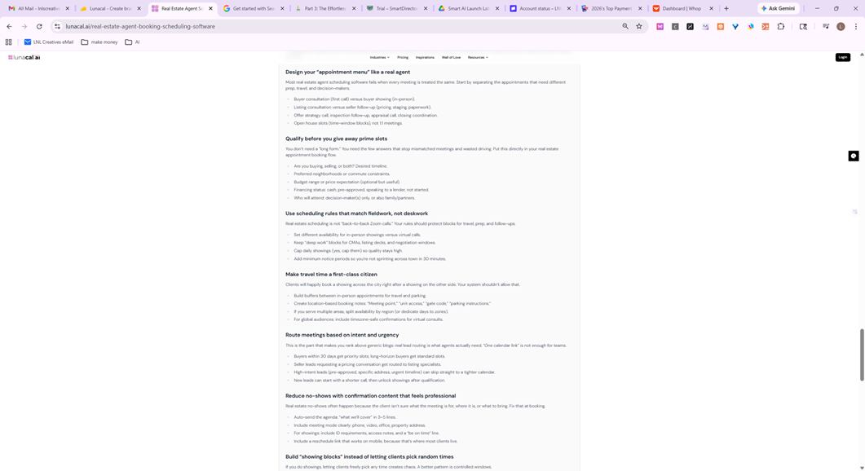

Slide 13
This playbook helps you set up real estate appointment booking so leads don’t ghost, showings don’t collide, and your calendar stops running your life.
Design your “appointment menu” like a real agent
Most real estate agent scheduling software fails when every meeting is treated the same. Start by separating the appointments that need different prep, travel, and decision-makers.
Buyer consultation (first call) versus buyer showing (in-person).
Listing consultation versus seller follow-up (pricing, staging, paperwork).
Offer strategy call, inspection follow-up, appraisal call, closing coordination.
Open house slots (time-window blocks), not 1:1 meetings.
Qualify before you give away prime slots
You don’t need a “long form.” You need the few answers that stop mismatched meetings and wasted driving. Put this directly in your real estate appointment booking flow.
Are you buying, selling, or both? Desired timeline.
Preferred neighborhoods or commute constraints.
Budget range or price expectation (optional but useful).
Financing status: cash, pre-approved, speaking to a lender, not started.
Who will attend: decision-maker(s) only, or also family/partners.
Use scheduling rules that match fieldwork, not deskwork
Real estate scheduling is not “back-to-back Zoom calls.” Your rules should protect blocks for travel, prep, and follow-ups.

Slide 14
Set different availability for in-person showings versus virtual calls.
Keep “deep work” blocks for CMAs, listing decks, and negotiation windows.
Cap daily showings (yes, cap them) so quality stays high.
Add minimum notice periods so you’re not sprinting across town in 30 minutes.
Make travel time a first-class citizen
Clients will happily book a showing across the city right after a showing on the other side. Your system shouldn’t allow that.
Build buffers between in-person appointments for travel and parking.
Create location-based booking notes: “Meeting point,” “unit access,” “gate code,” “parking instructions.”
If you serve multiple areas, split availability by region (or dedicate days to zones).
For global audiences: include timezone-safe confirmations for virtual consults.
Route meetings based on intent and urgency
This is the part that makes you rank above generic blogs: real lead routing is what agents actually need. “One calendar link” is not enough for teams.

Slide 15
Make travel time a first-class citizen
Clients will happily book a showing across the city right after a showing on the other side. Your system shouldn’t allow that.
Build buffers between in-person appointments for travel and parking.
Create location-based booking notes: “Meeting point,” “unit access,” “gate code,” “parking instructions.”
If you serve multiple areas, split availability by region (or dedicate days to zones).
For global audiences: include timezone-safe confirmations for virtual consults.
Route meetings based on intent and urgency
This is the part that makes you rank above generic blogs: real lead routing is what agents actually need. “One calendar link” is not enough for teams.

Slide 16
Buyers within 30 days get priority slots; long-horizon buyers get standard slots.
Seller leads requesting a pricing conversation get routed to listing specialists.
High-intent leads (pre-approved, specific address, urgent timeline) can skip straight to a tighter calendar.
New leads can start with a shorter call, then unlock showings after qualification.
Reduce no-shows with confirmation content that feels professional
Real estate no-shows often happen because the client isn’t sure what the meeting is for, where it is, or what to bring. Fix that at booking.
Auto-send the agenda: “what we’ll cover” in 3–5 lines.
Include meeting mode clearly: phone, video, office, property address.
For showings: include ID requirements, access notes, and a “be on time” line.
Include a reschedule link that works on mobile, because that’s where most clients live.
Build “showing blocks” instead of letting clients pick random times
If you do showings, letting clients freely pick any time creates chaos. A better pattern is controlled windows.
Create showing windows like “Saturday Showings (2-hour block)” and then confirm the exact property order after.
Or offer fixed showing start times that align with your route planning (for example, top of the hour only).
Keep a separate “same-day showing request” option that triggers a quick approval workflow.
Use team scheduling rules that don’t create internal conflict
If you’re a brokerage team, “round-robin” alone can be a mess. Real estate teams need fairness and context.
Round-robin only for new inbound leads; route repeat clients back to the same agent.
Make coverage rules explicit: weekends, evenings, vacation coverage, time-off protection.
Lock certain meeting types to certain roles (listing consults to listing agents, showing assistants to showings).
Ensure notes collected at booking are visible to the assigned agent instantly.

Slide 17
Track lead source without annoying the client
Real estate agent scheduling software should help you learn which channels actually produce serious clients, without asking invasive questions.
Add a simple “How did you find me?” field (referral, Instagram, Google, portal, signboard, other).
Store UTM/source data automatically if the booking link comes from ads or campaigns.
Tag bookings by appointment type so you can see what converts into transactions.
Copy-paste templates that make your booking flow feel premium
These small lines reduce confusion and protect your time, especially for first-time buyers and sellers.
Buyer consult intro: “We’ll clarify your timeline, budget range, preferred areas, and next steps so you leave with a plan.”
Showing expectations: “Please arrive on time. If you’re more than 10 minutes late, we may need to reschedule to respect access windows and other appointments.”
Reschedule nudge: “If your schedule changes, please use the reschedule link instead of replying to the confirmation message.”
What to prepare: “If you have a lender pre-approval letter or a target monthly budget, bring it. If not, no stress, we’ll cover options.”

